Slide 1
Pocket Beasts Design review
Kuno DLK

Slide 2
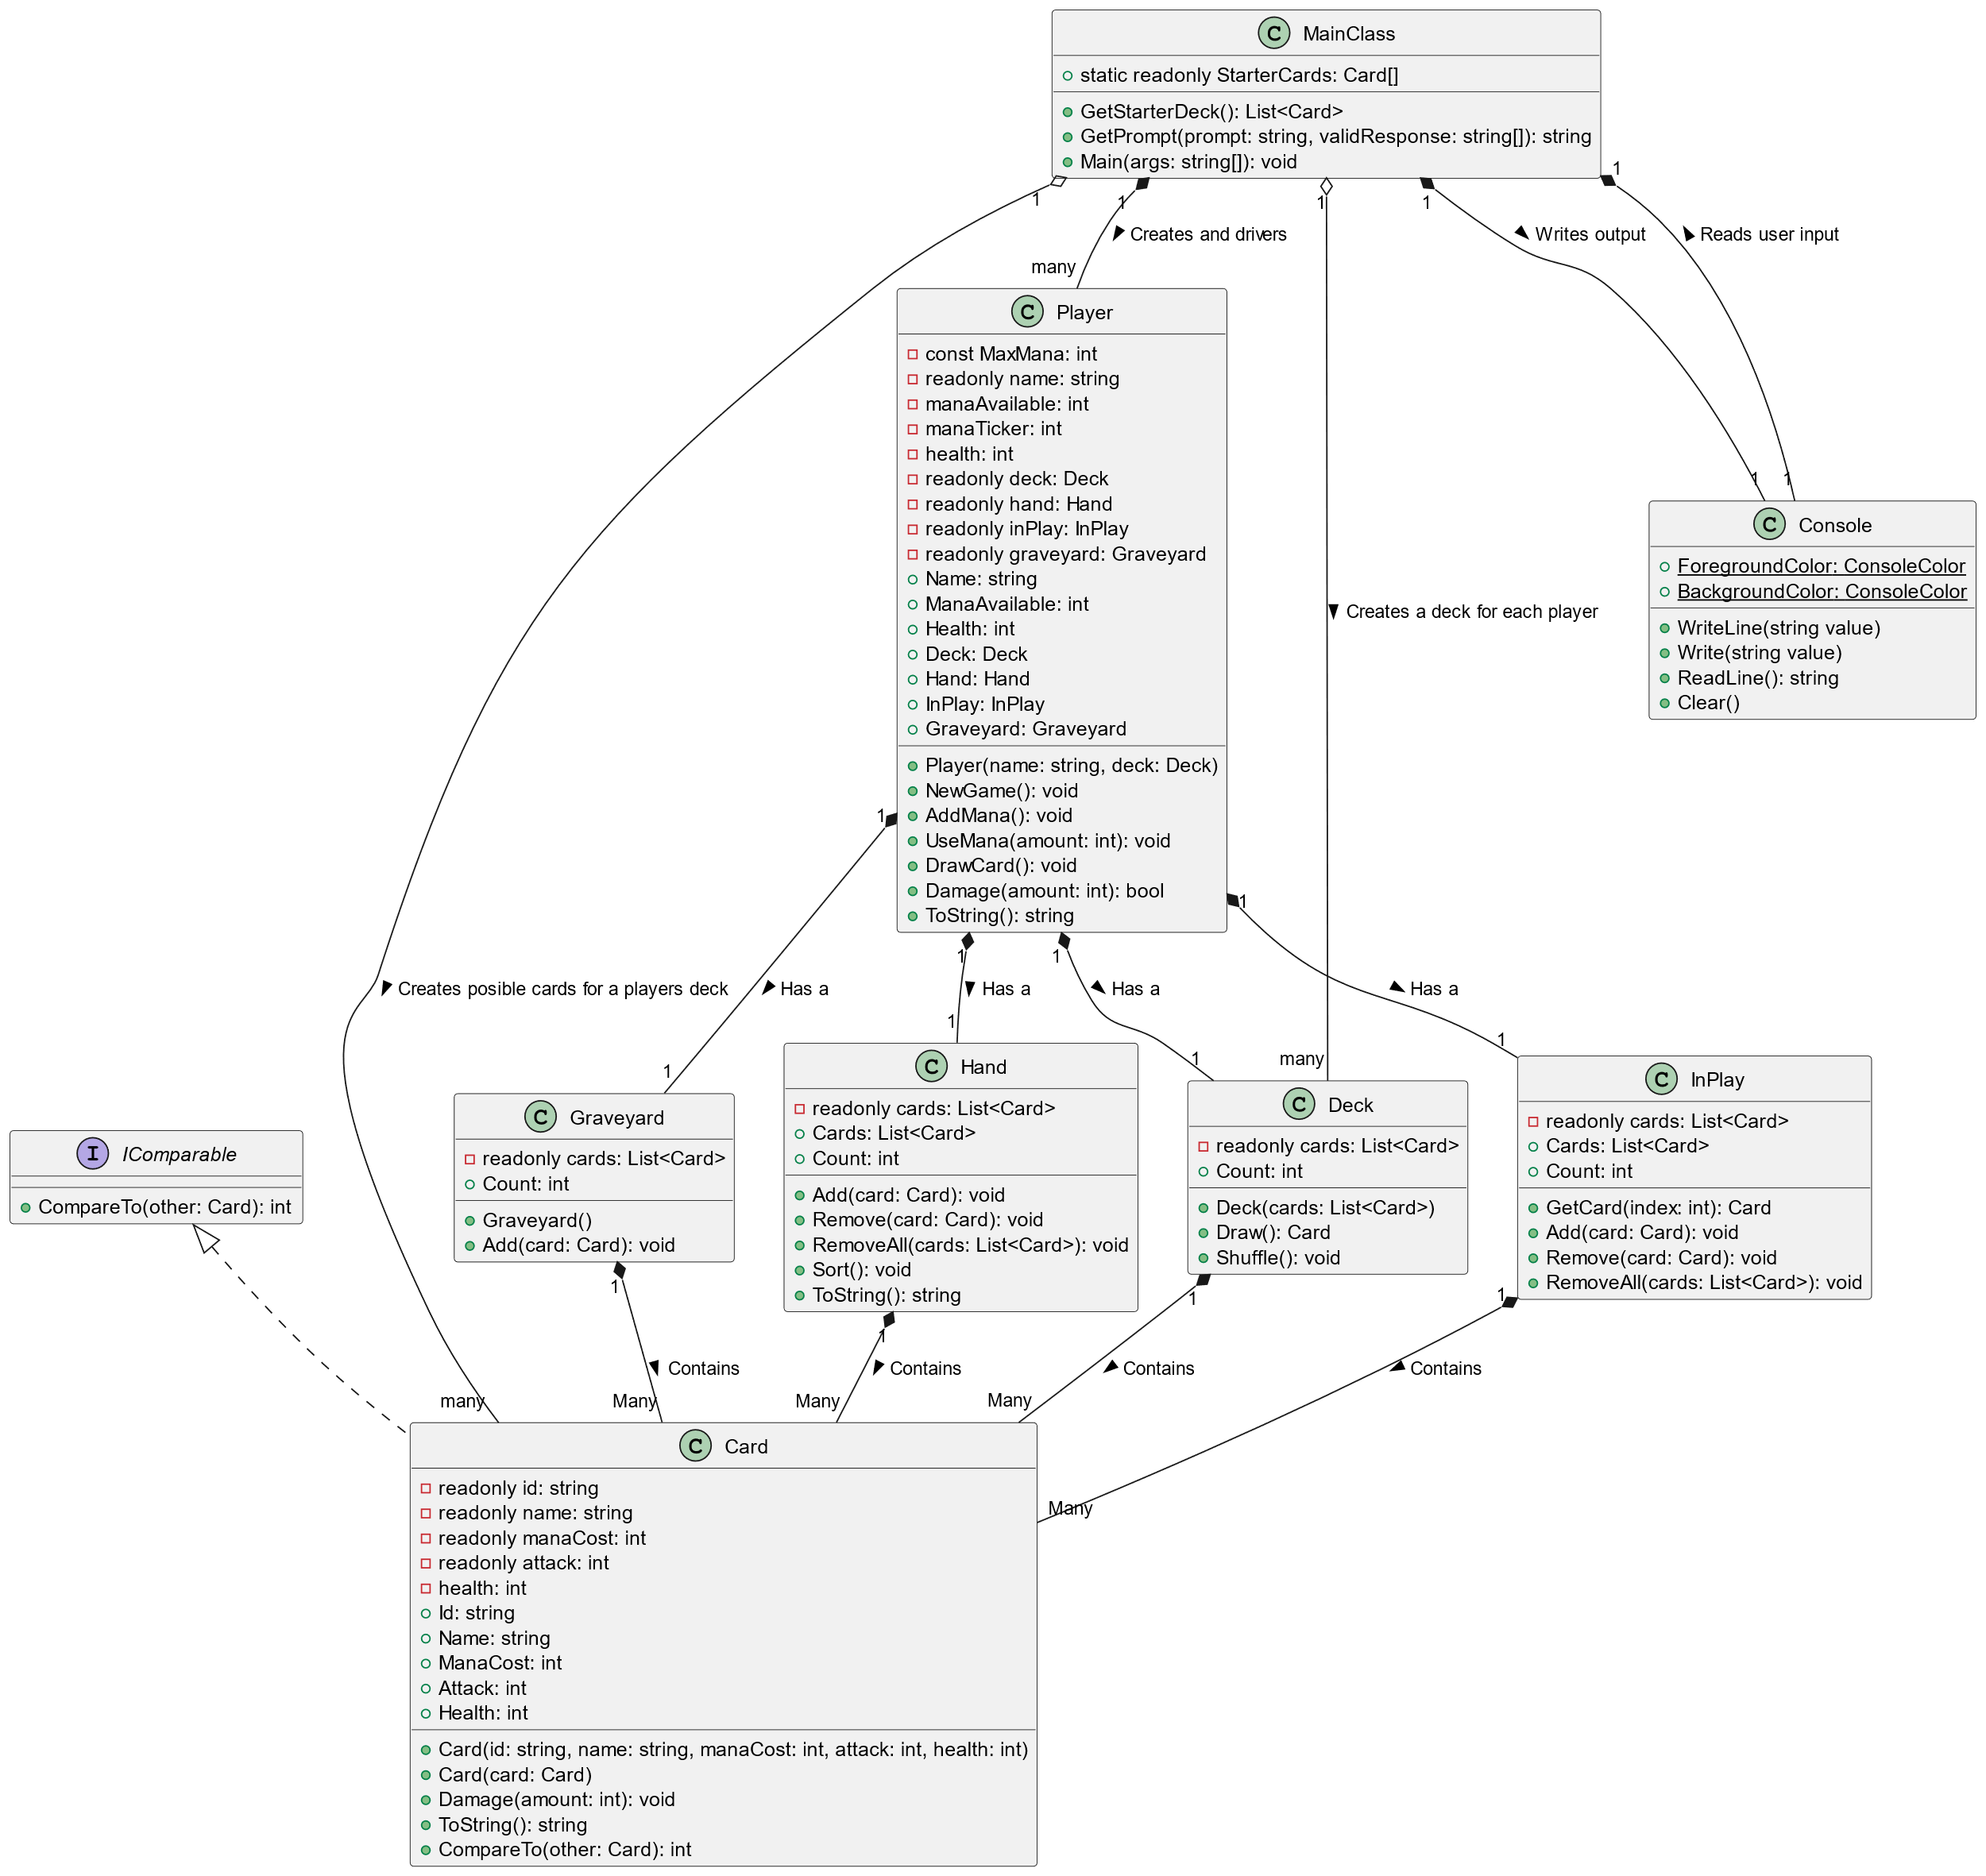
Aims of presentation
Identify And Discuss
Design Weaknesses
Implementations weaknesses
Proposed Improvement
Object orientated design principles
Appropriate use of abstract classes and interfaces
“PocketBeast” Cards Design
Decorator? Façade? Strategy? (Patterns)

Slide 3
Current Design: Let’s have a looks at what’s not the best

Slide 4
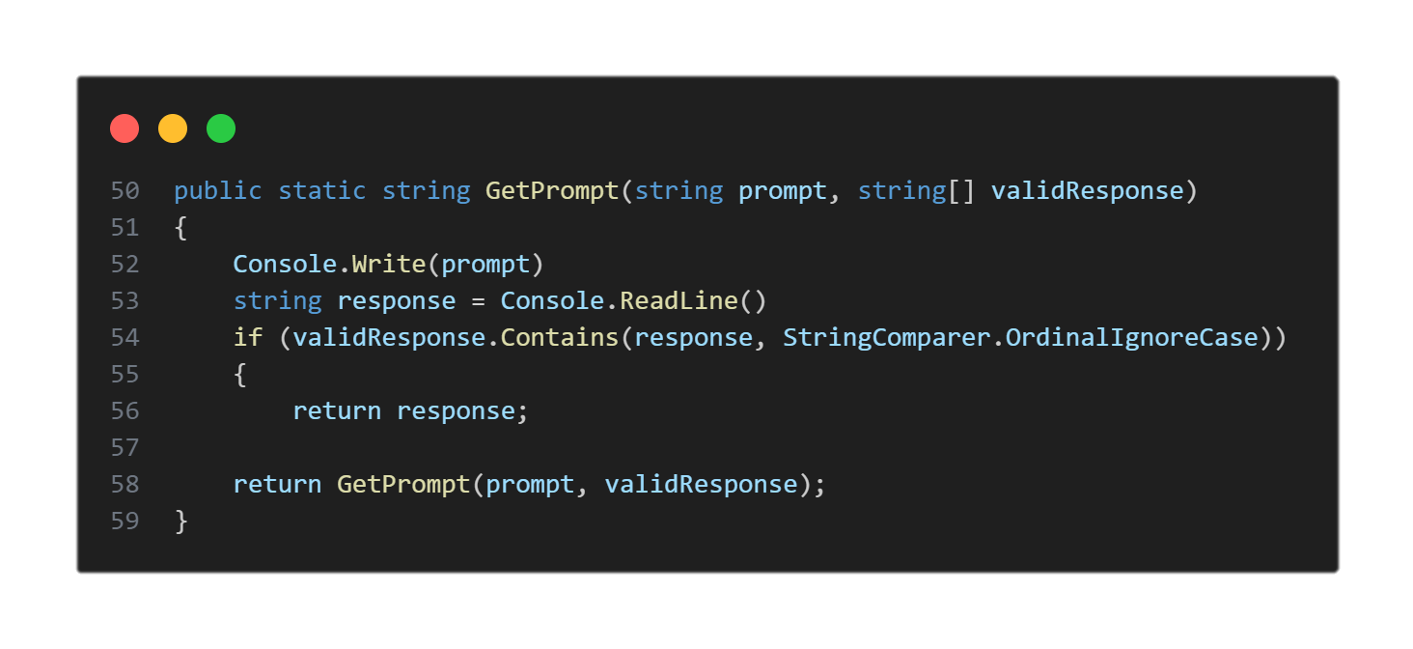
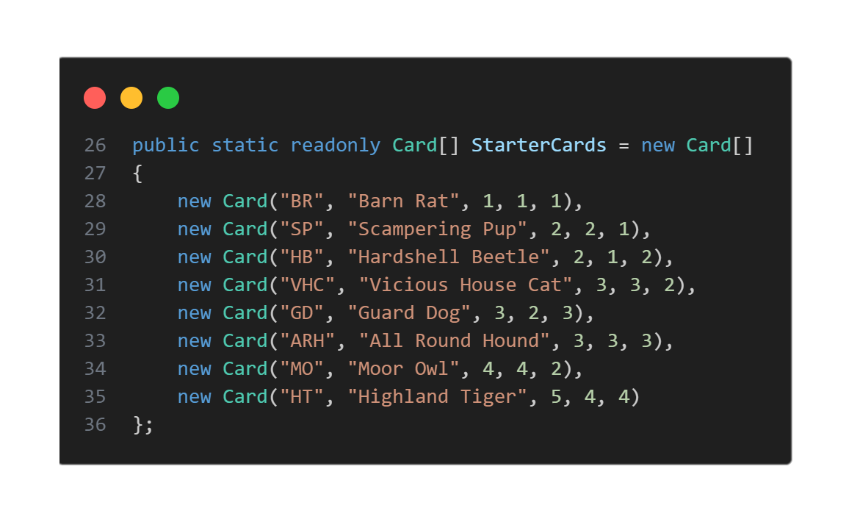
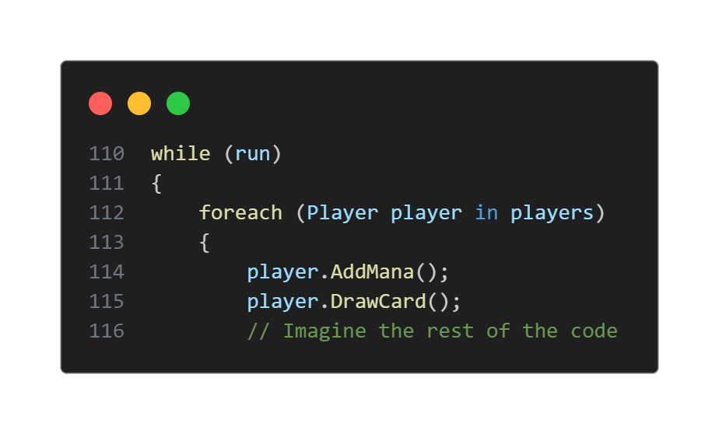
MainClass Too much responsibility! - Display game - User Interaction - Game Logic - Players - Decks

Slide 5
MainClass Too much responsibility! - Display game - User Interaction - Game Logic - Players - Decks
User Interface
Game Logic
Hard Coded Game Decks

Slide 6
Player: Player know too much about the game. Not all games will have the same attributes for the players

Slide 7
Card Containers: Lack of Abstraction Many class having duplicated methods Violates D.R.Y (Don’t Repeat Yourself) principles

Slide 8
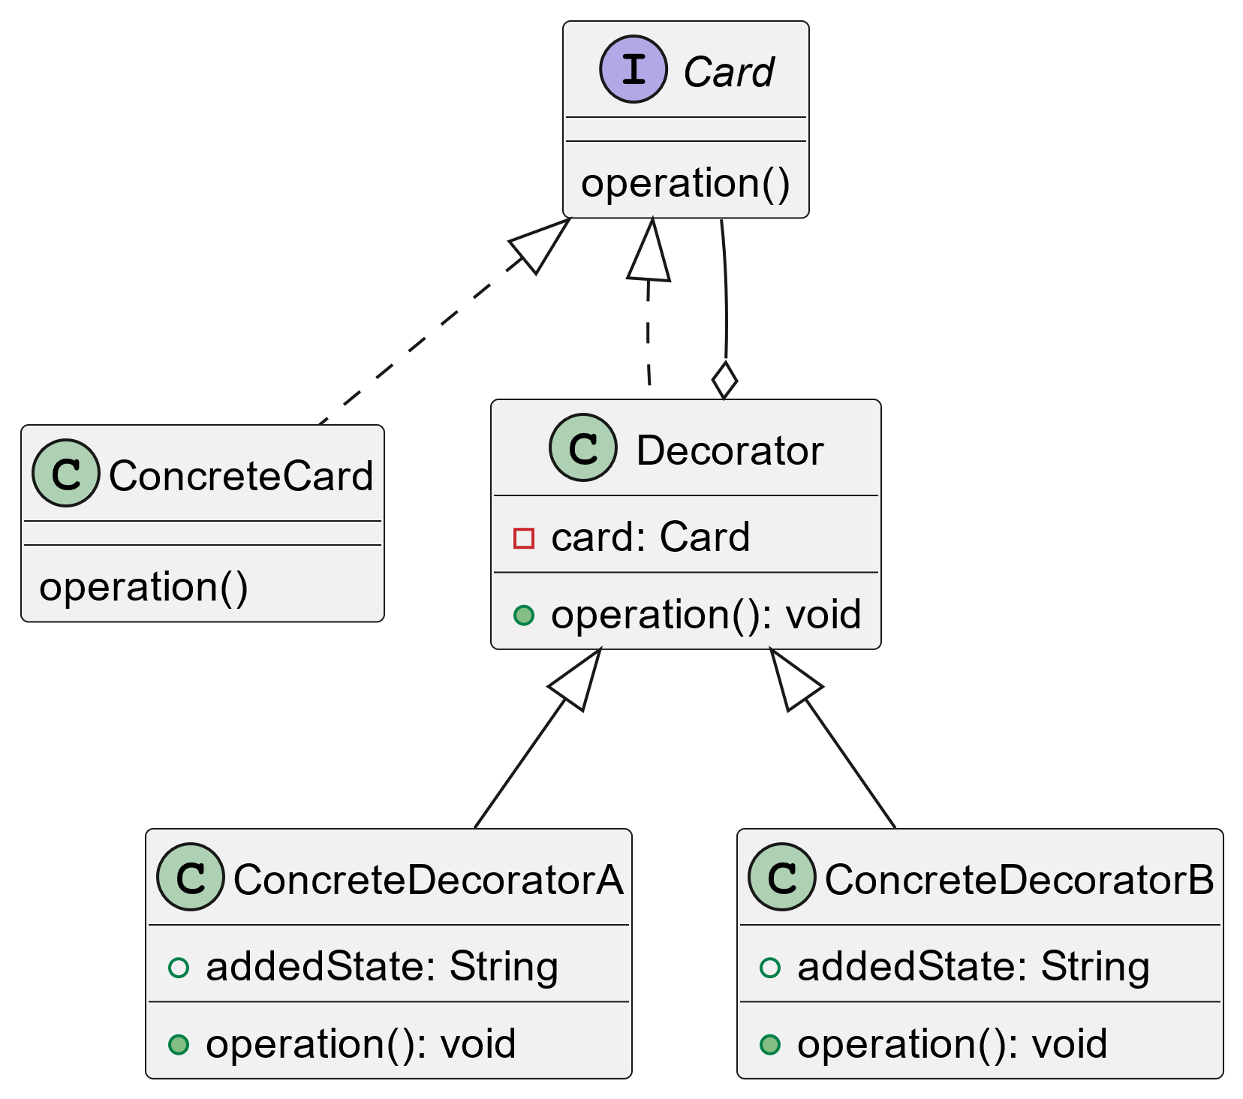
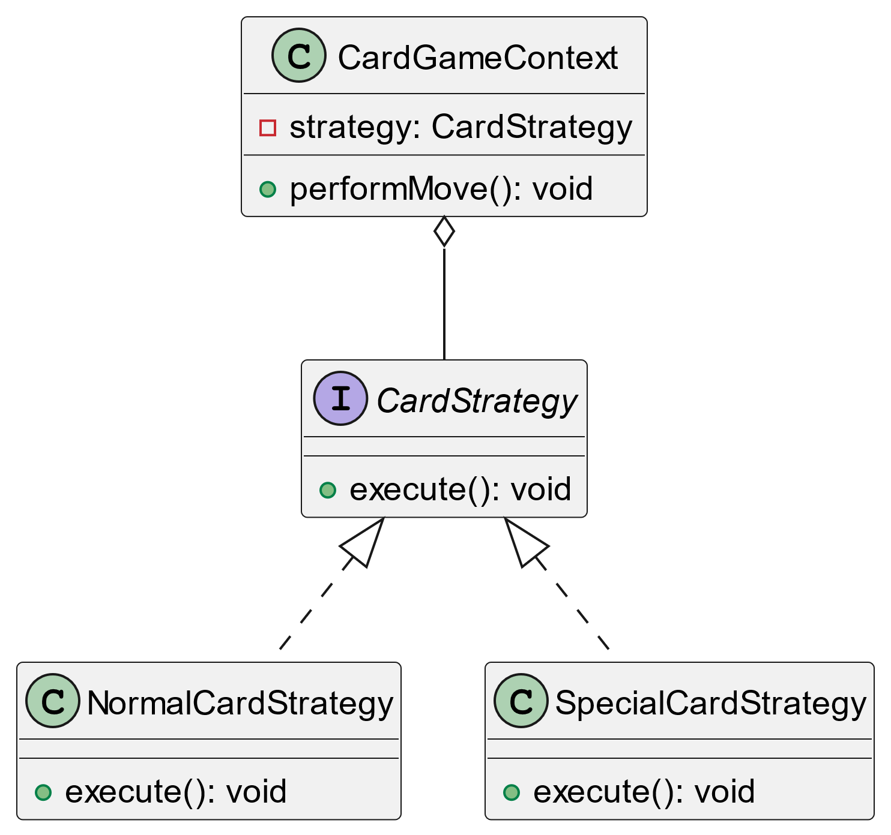
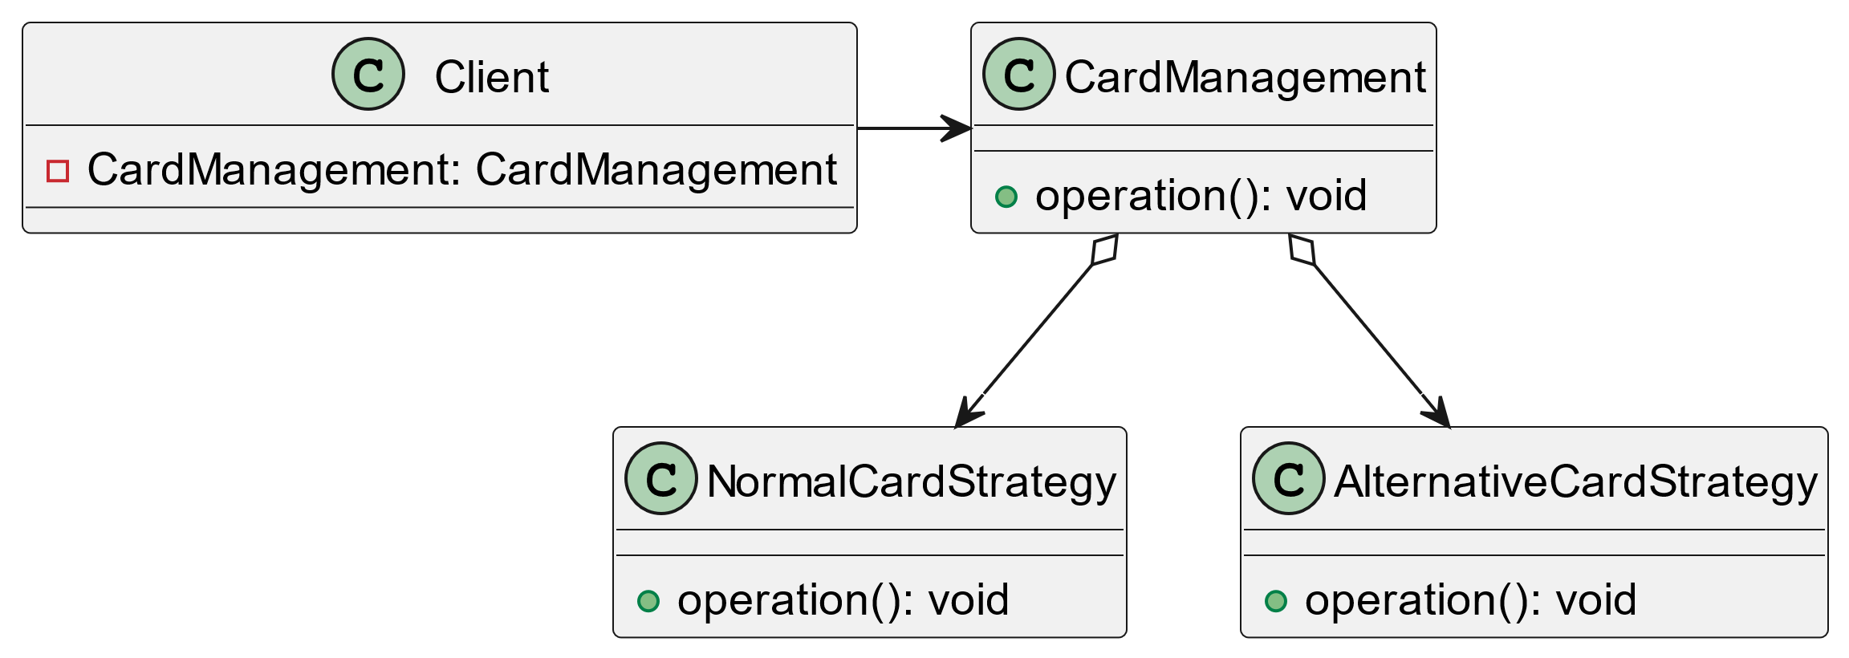
Card: Class is okay however very rigid It assumes all cards work in the same way and cards never change their properties
Decorator
Façade
Strategy

Slide 9
Modifying card behaviours
Property | Strategy | Façade | Decorator
Complexity to construct | Just need reference to the manager | Construct Correct Strategy | Hard Mode
Maintainability | Manger Class Could Get Overly Spaghetti | Fair | Very Flexible As Multiple Strategies Can Be Used At Once
Debuggability | Excellent, All Concrete Classes | Fair, Simple Point Of Abstraction | Hard, A Problem Could Be In One Of The Many Decorators
Good For | Switching Between Few Well Defined Paths (E.G. Switching Between Wi-Fi/Ethernet) | Switch Between Many Similar Classes that have common Functionality (E.G. Hardware Controll) | Extend The Functionality Of A Existing System (E.G. Decoration Saving A file With Encryption )
There are 3 suitable patterns that could be used to modify the behaviour of cards
Decorator
Strategy
Façade

Slide 10
Let’s compare these:
Modifying card behaviours
There are 3 suitable patterns that could be used to modify the behaviour of cards
Property | Strategy | Façade | Decorator
Complexity to construct | Just need reference to the manager | Construct Correct Strategy | Hard Mode
Maintainability | Manger Class Could Get Overly Spaghetti | Fair | Very Flexible As Multiple Strategies Can Be Used At Once
Debuggability | Excellent, All Concrete Classes | Fair, Simple Point Of Abstraction | Hard, A Problem Could Be In One Of The Many Decorators
Good For | Switching Between Few Well Defined Paths (E.G. Switching Between Wi-Fi/Ethernet) | Switch Between Many Similar Classes that have common Functionality (E.G. Hardware Controll) | Extend The Functionality Of A Existing System (E.G. Decoration Saving A file With Encryption )
Decorator
Strategy
Façade

Slide 11
Time To Get To Work!

Slide 12
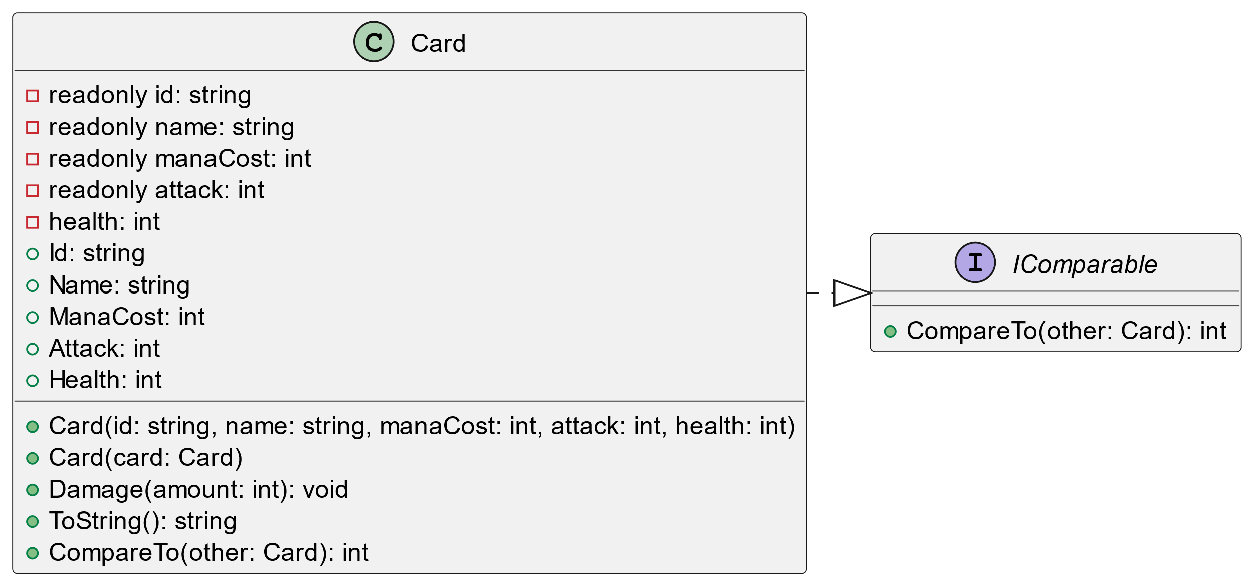
Let’s Start Bottom Up

Slide 13
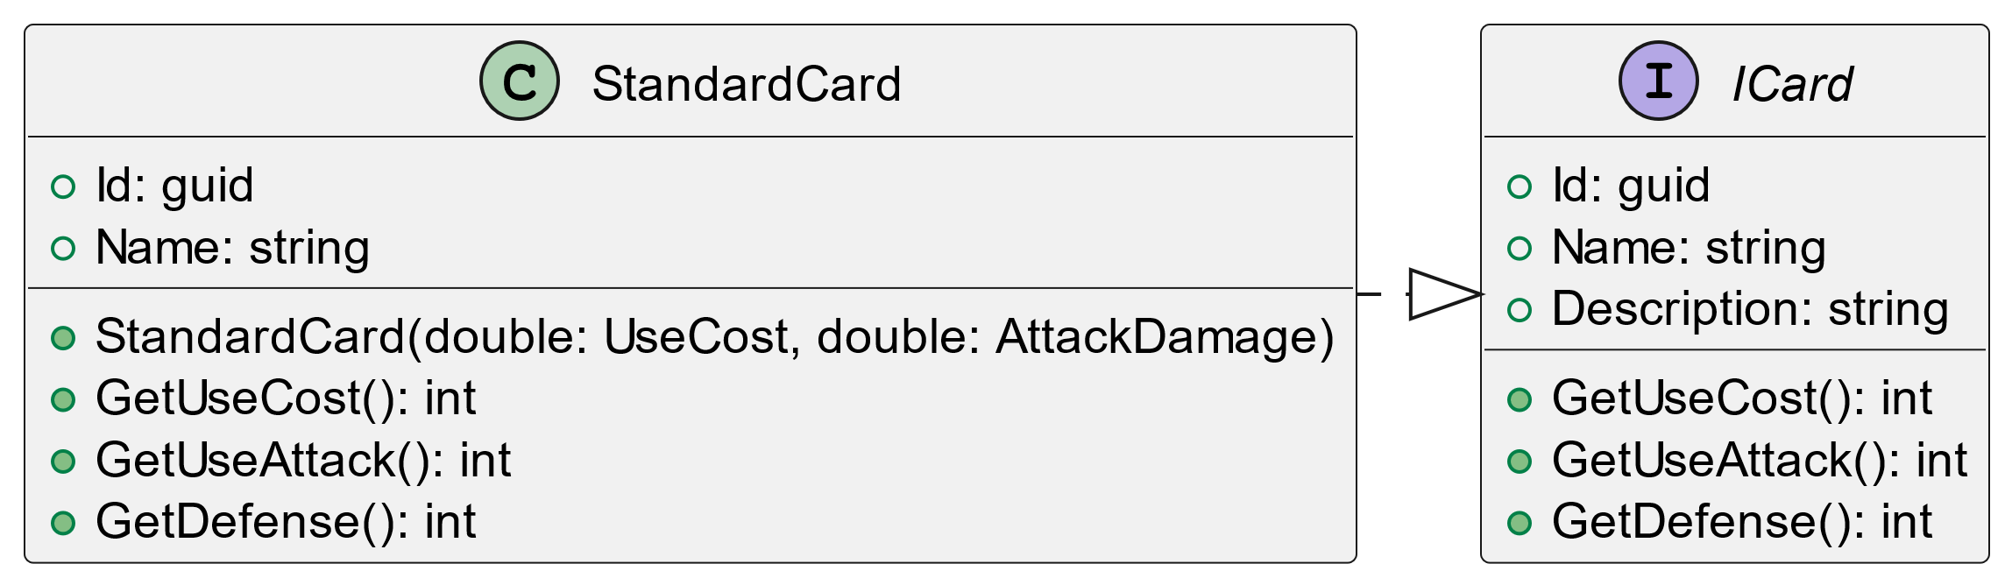
Let’s swap the card out for an interface with a concrete implementation

Slide 14
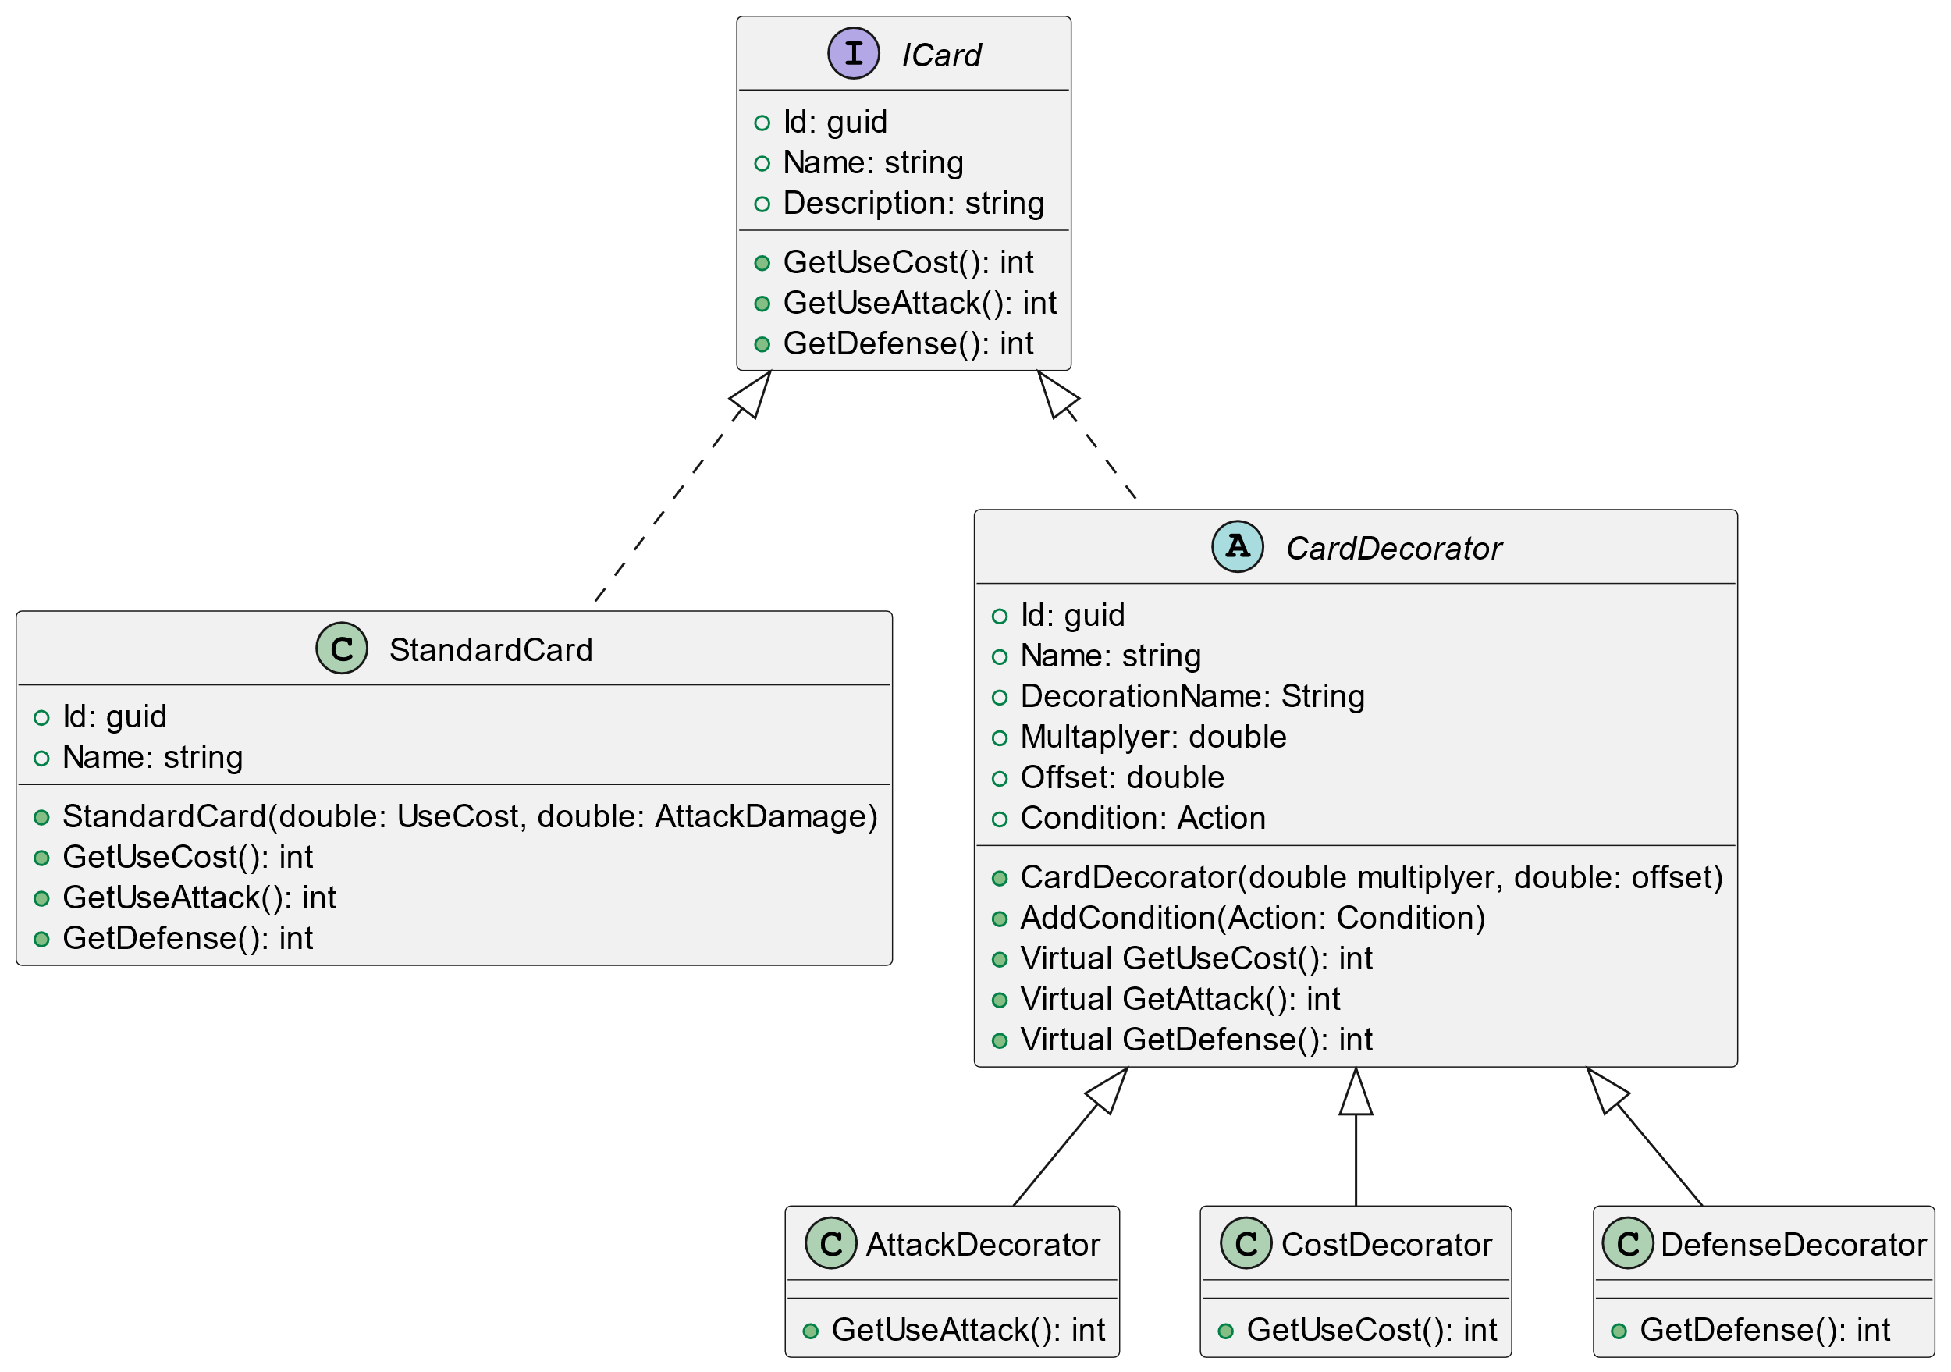
We will now add our decorator pattern

Slide 15
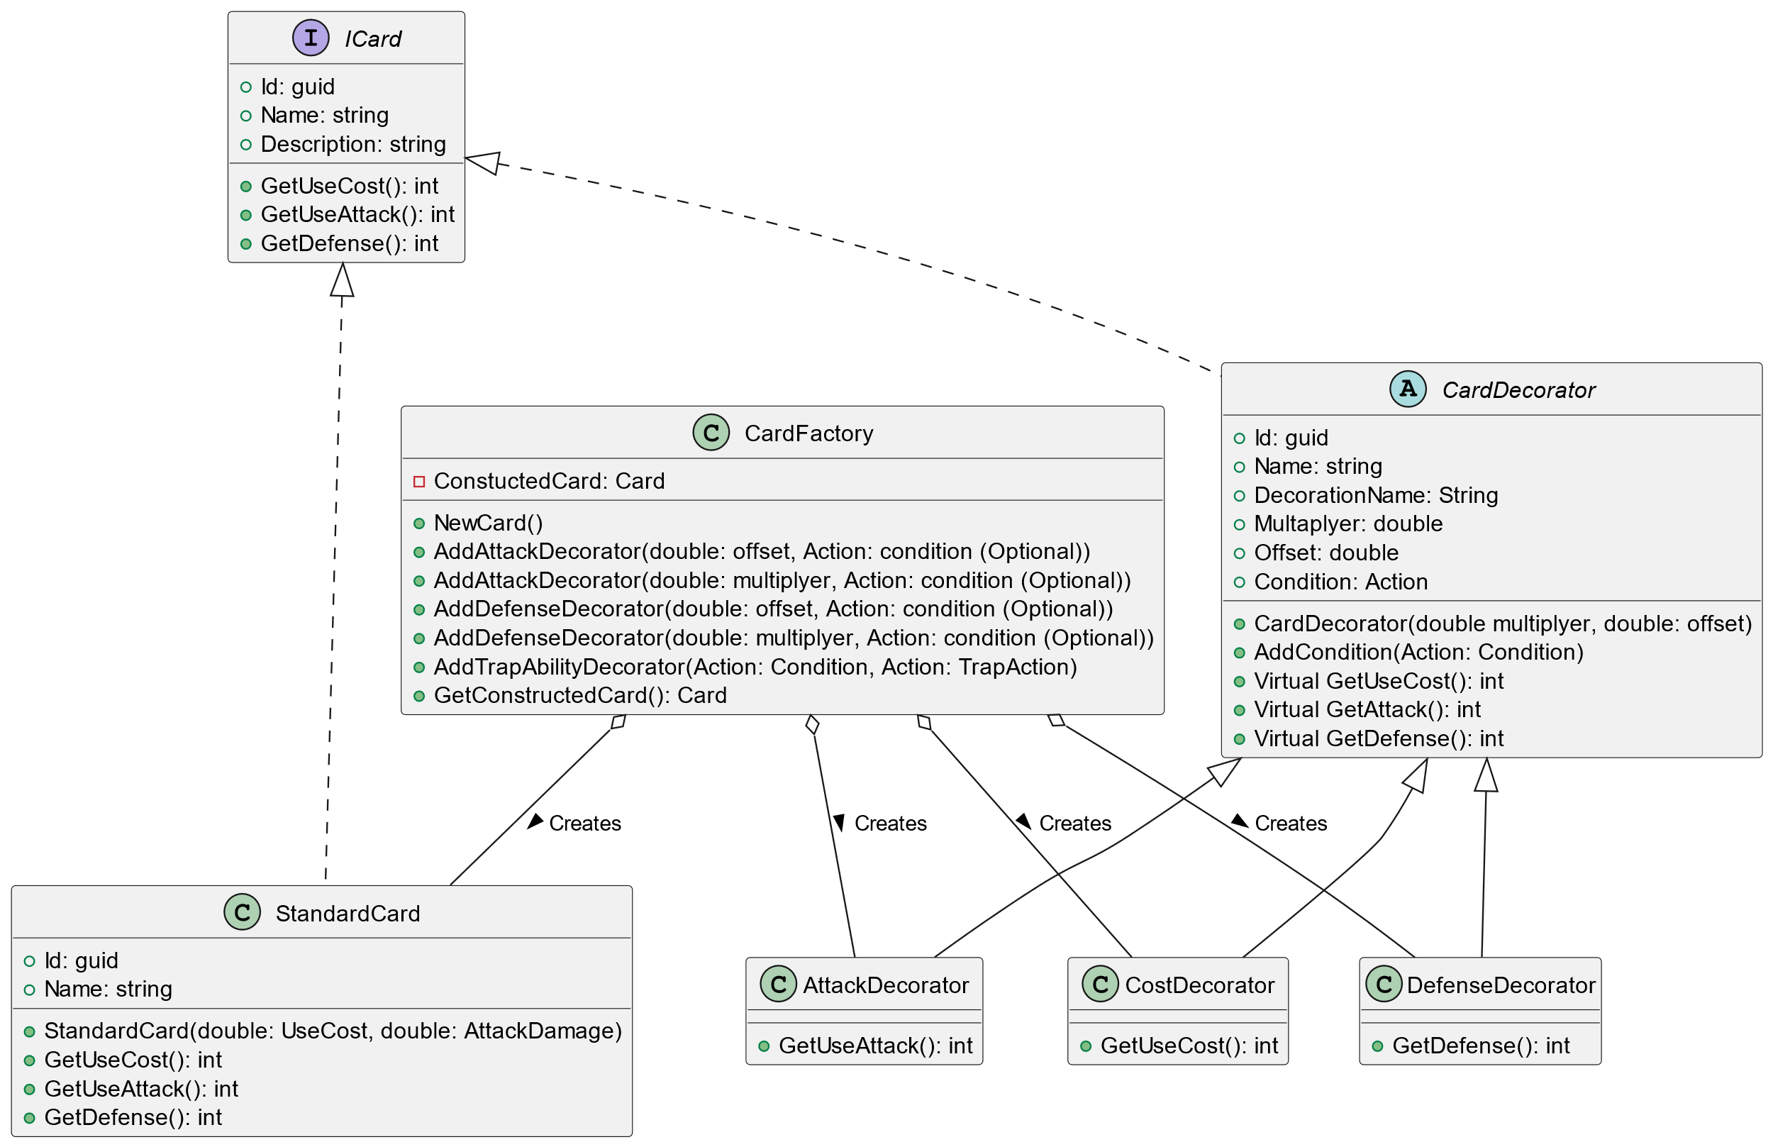
Abstract the complexity of creation to the factory

Slide 16
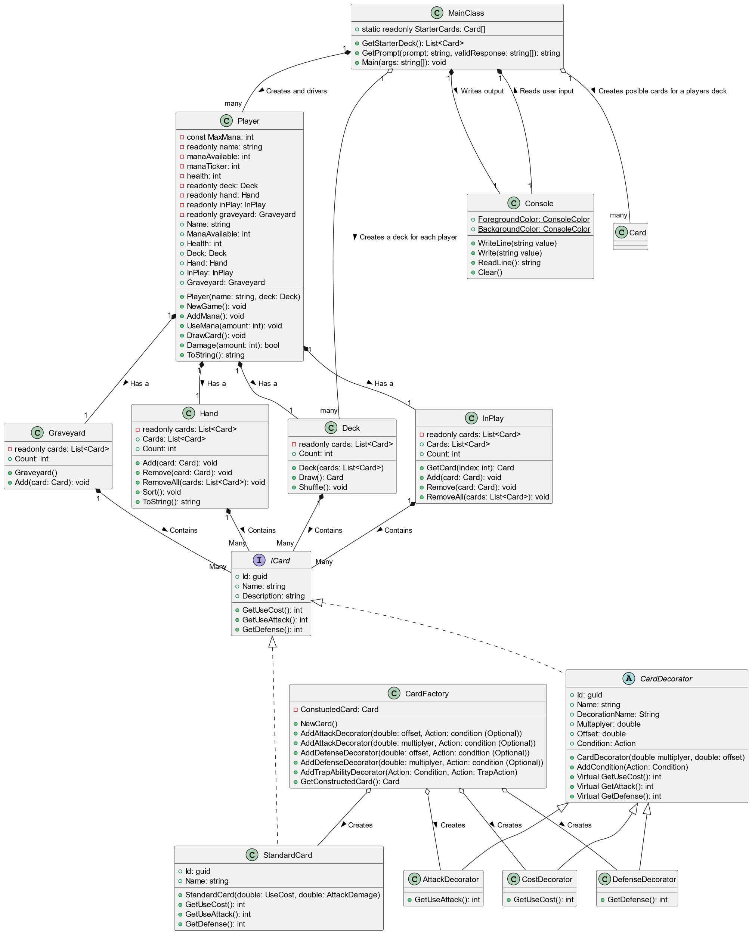
Let’s look at the bigger picture Good, but we are not done..

Slide 17
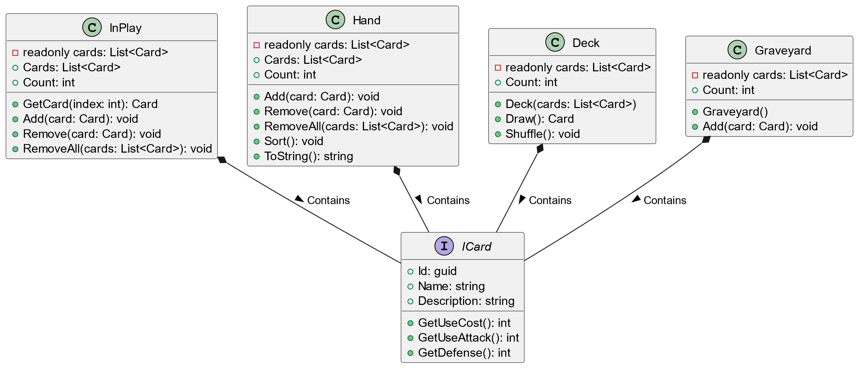
Abstract the complexity of creation to the factory

Slide 18
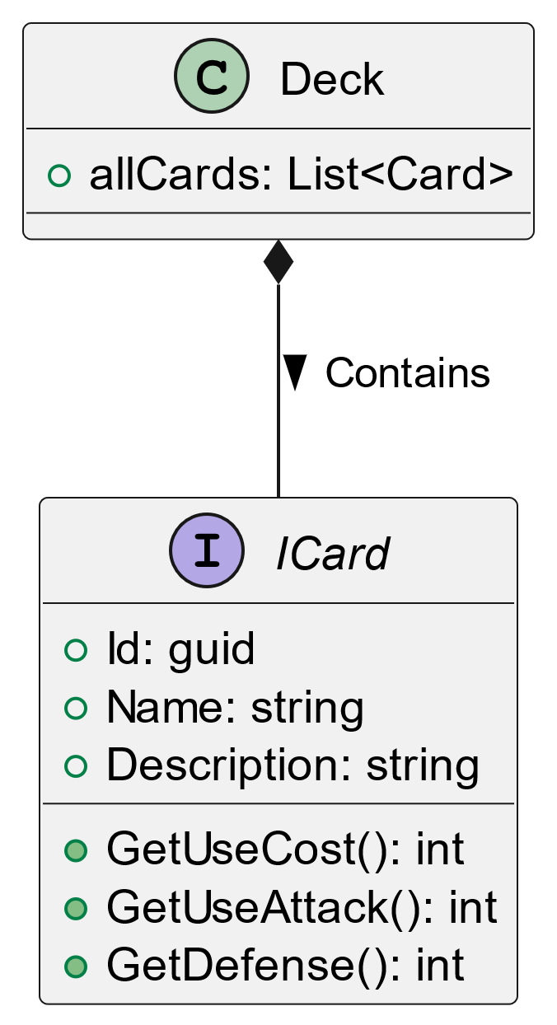
At the end of the day all players have many cards so we can model this as a “Deck” However, we will need to place these cards into different “Stacks”

Slide 19
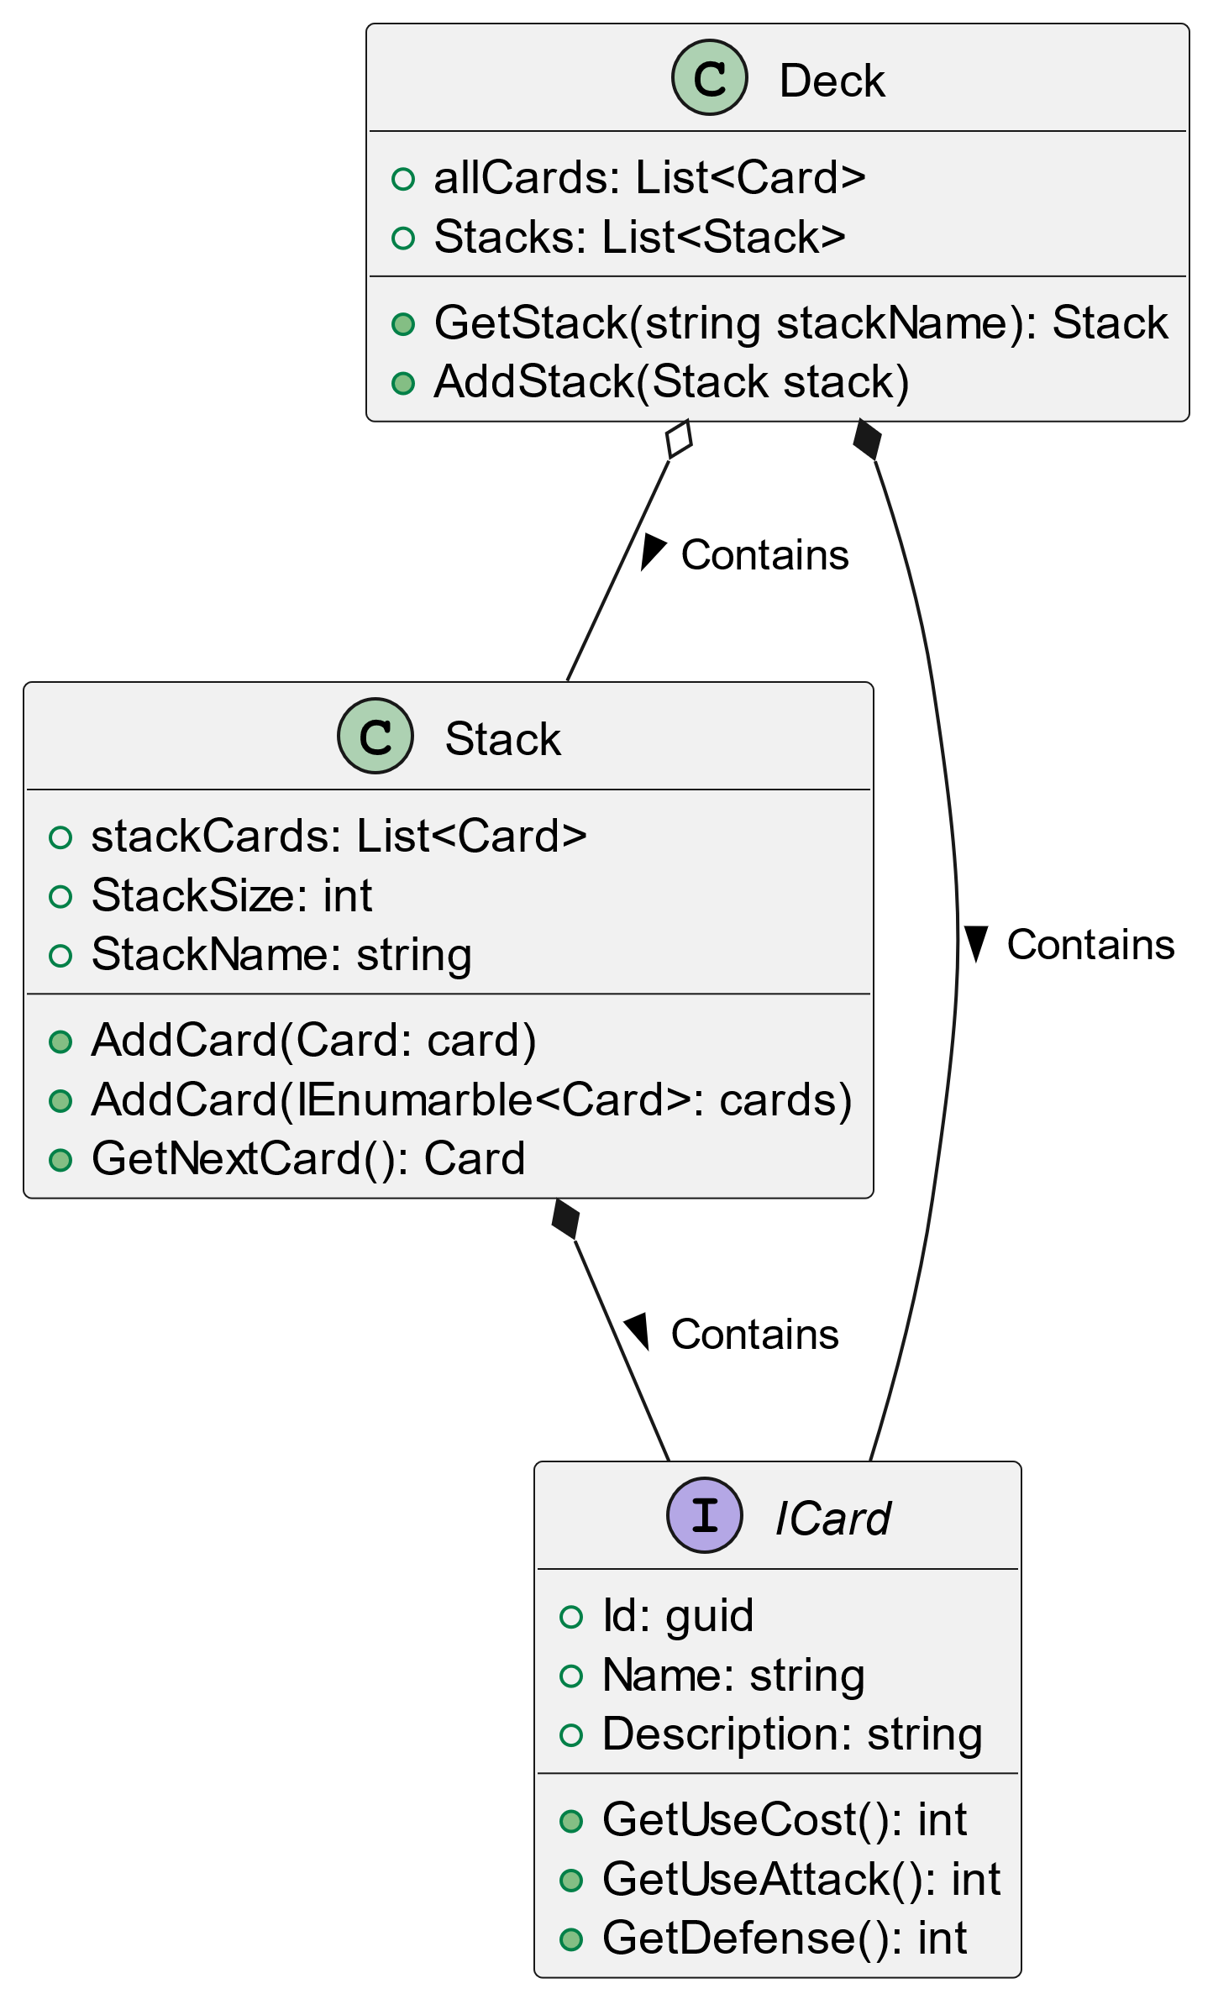
We can create containers that can contain many cards in a deck However, we might need to sort or shuffle these stacks

Slide 20
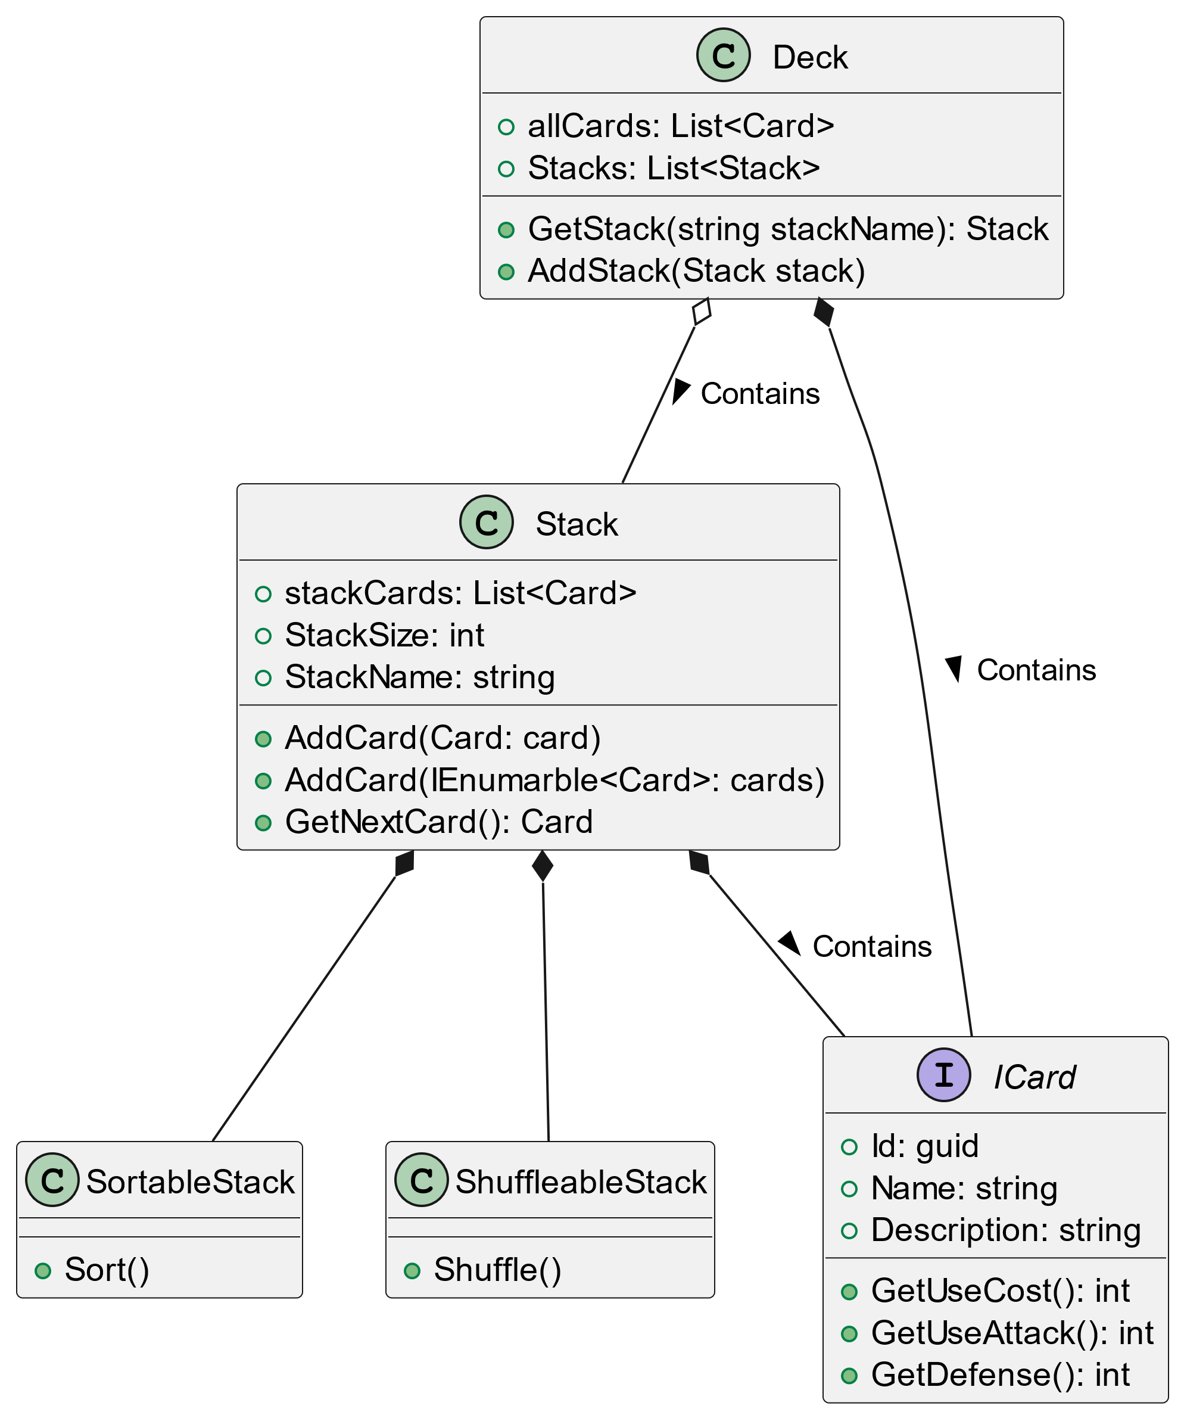
We can create containers that can contain many cards in a deck However, we might need to sort or shuffle these stacks

Slide 21
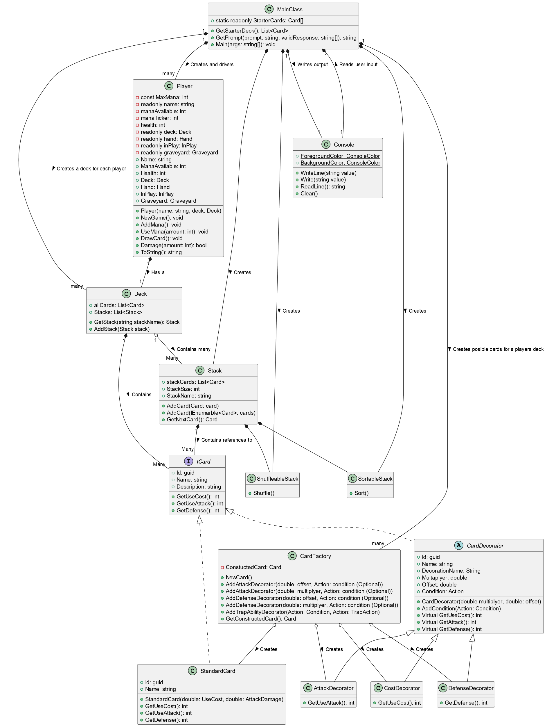
Now we are getting there: Very extendable, but at the cost of complexity Final battle is to unburden the main class

Slide 22
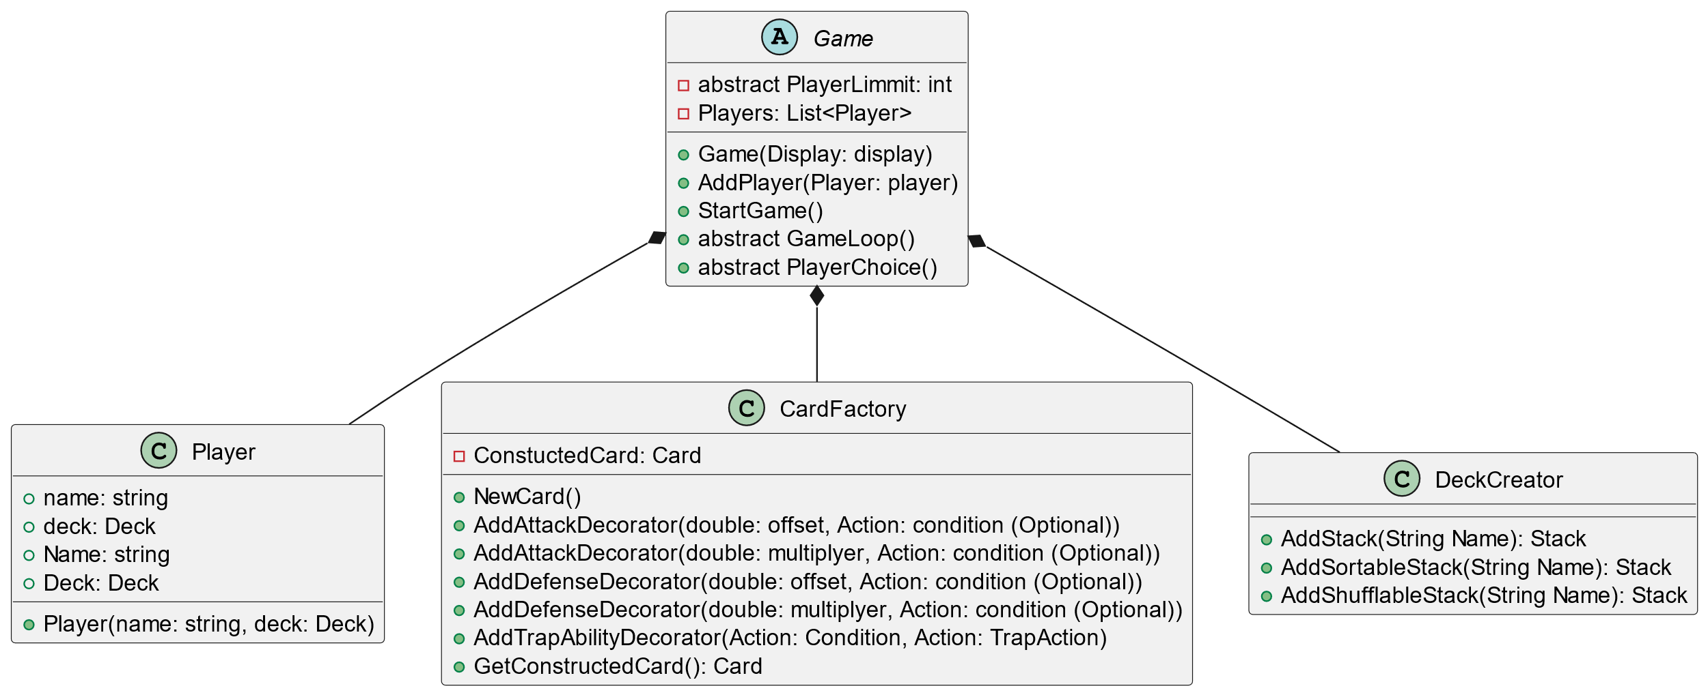
This is a big task so let’s start from the top this time Let’s start with a Game with players and give the game ability to create the game stacks and cards

Slide 23
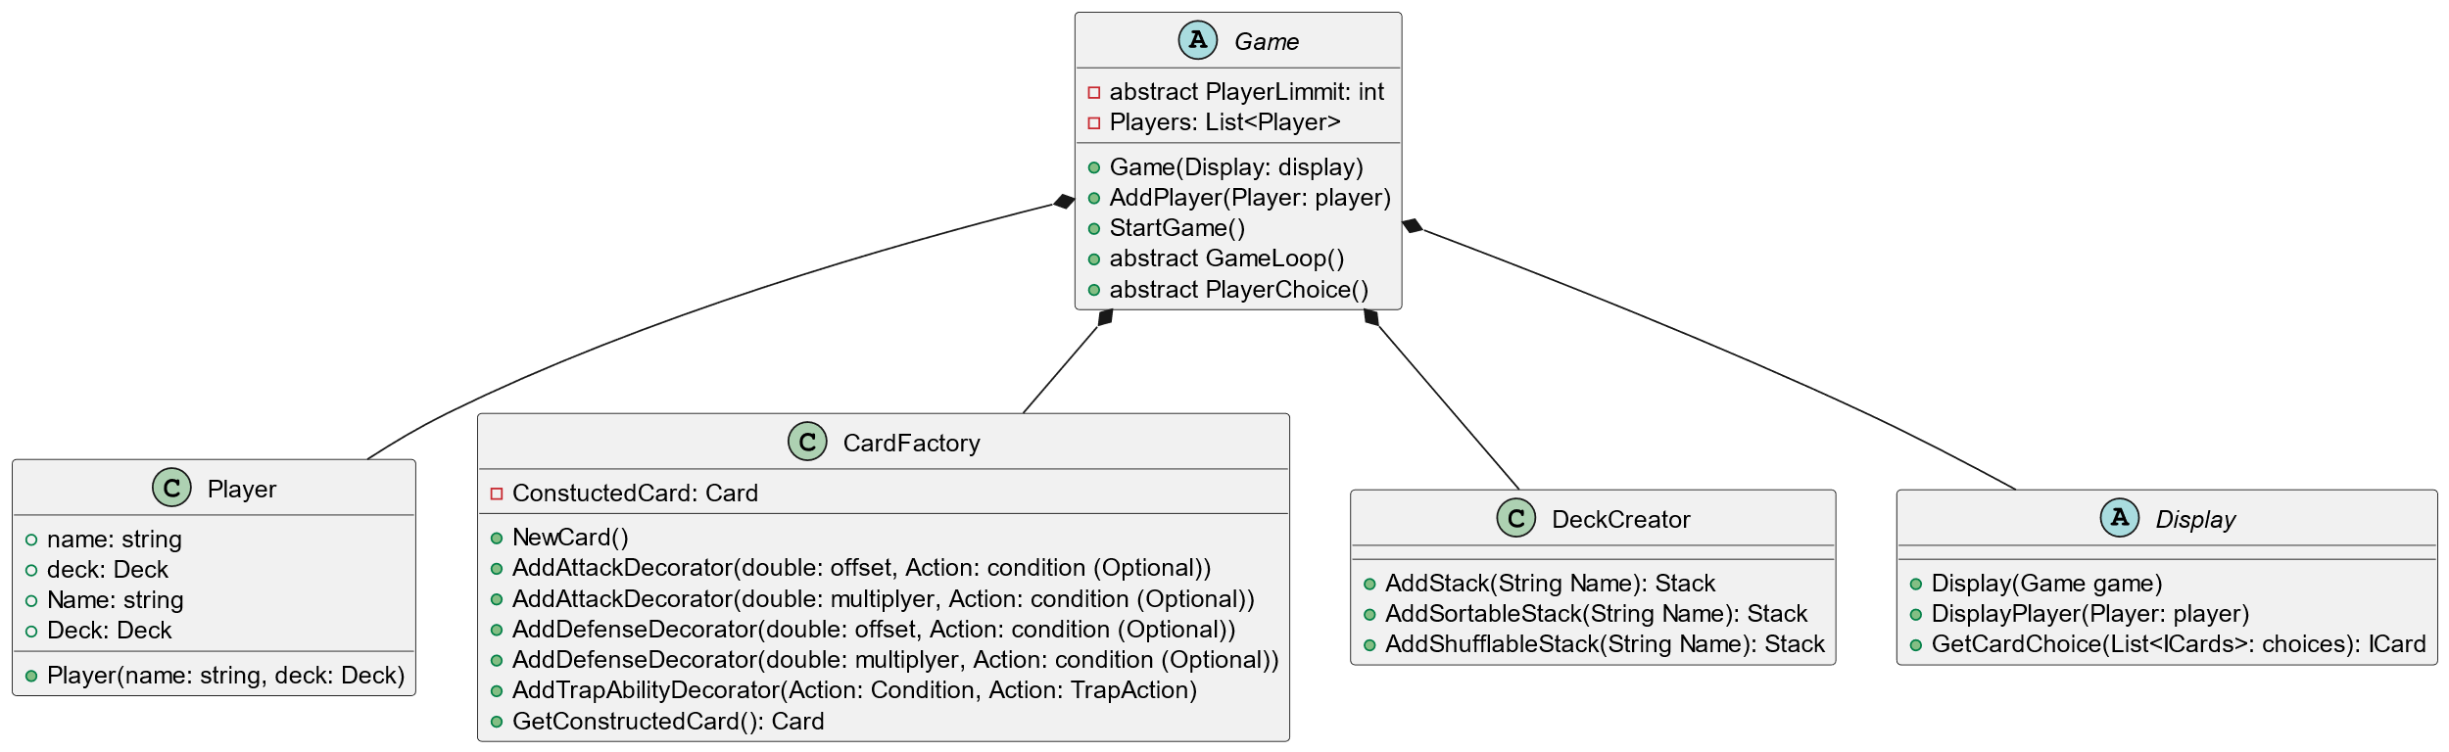
However, we need a way to display the game to the player so we can add a display. This removes responsibility from the player class to the game implementation

Slide 24
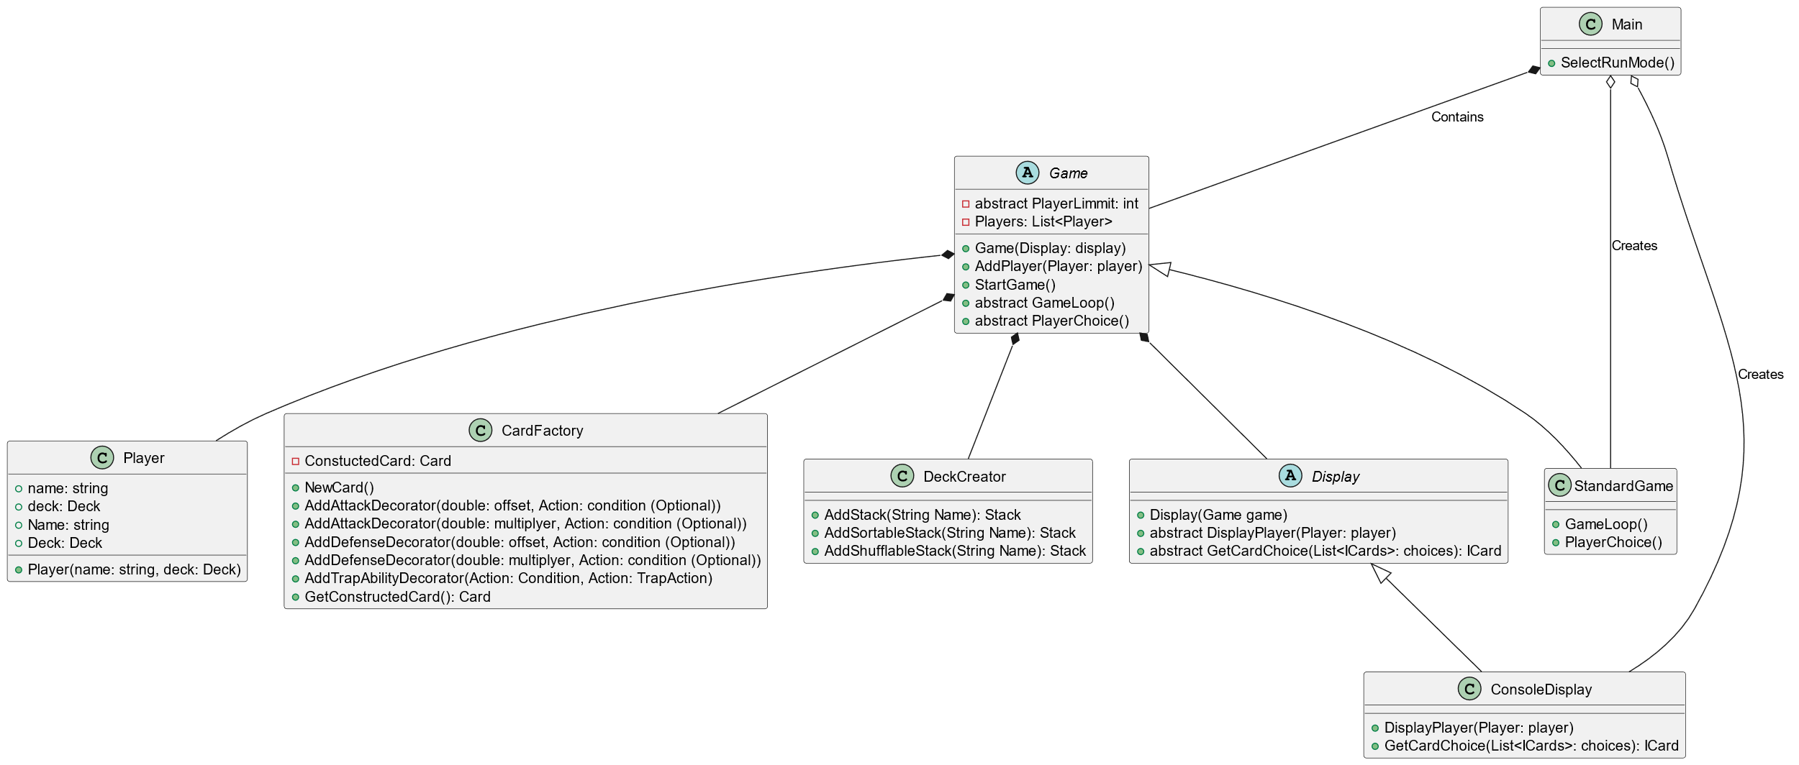
Some Implementation can be added for the current game mode and the console display. This makes the only responsibility for the main class is to create the correct game type with the correct display

Slide 25
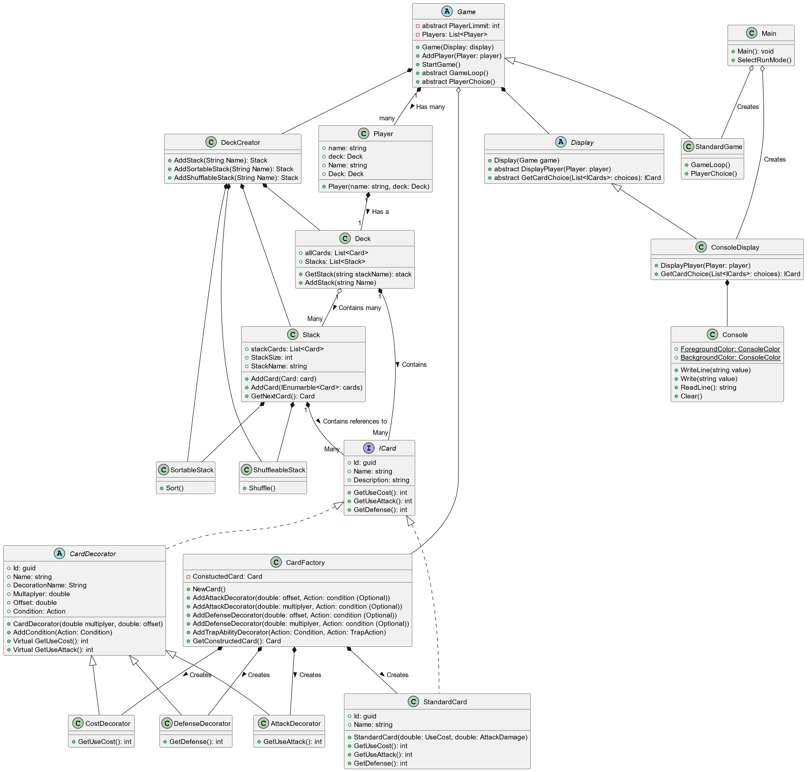
With adding it all back to gather we are left with this. This design is extremely complex however provides great flexibility for future modifications.

